Slide 1
LoboTime Employee Navigation PC User Job Aid
The purpose of this job aid is to provide the employee an overview of navigation inside of the LoboTime system.

Slide 2
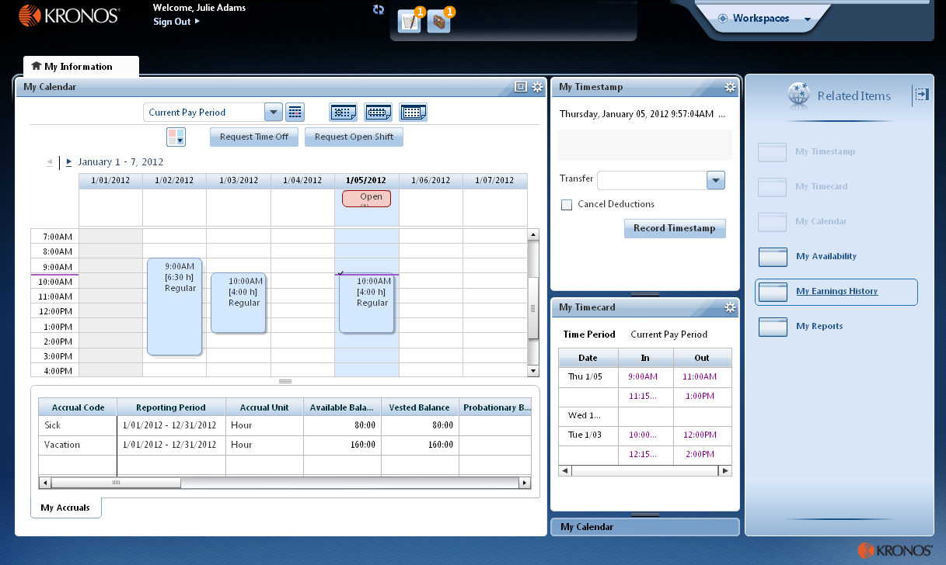
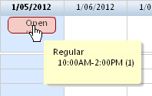
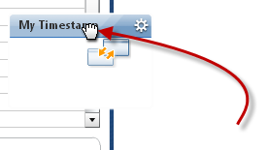
Employee Navigator Job Aid
Parts of a Navigator
Active Bar Displays active workspaces; click title to bring a workspace into focus. (My Information is the only one in this example.)
Name / Sign Out Identifies user and a link to log out of navigator.
Alerts Links, which appear as icons, enabling you to quickly view the type and number of tasks and issues that you need to address. (Note: Alerts are optional)
Carousel Container for one or more workspaces (Note: Carousel appears only if there is another workspace in addition to the home workspace.)
Navigator layout varies
Navigators are customized by Administrators and reflect those items needed for a job role. Specific widgets and alerts that are available in your navigator are determined by your access and which applications are in use.
Hovering for Details Hover the mouse to see details, where applicable.
Repositioning Widgets Move a secondary widget into a primary position by clicking the title bar, dragging it over a primary widget, and releasing.
Workspace Displays one or more widgets and the Related Items pane.
Widgets A widget is a task-oriented tool or view into Workforce Central. There will be one or two primary widgets, depending on the workspace—these are widgets you can use to perform tasks. There may also be one or more smaller-sized secondary widgets, but normally these are for viewing only until you swap them into a primary position.
Related Items Pane Includes one or more additional widgets for less common tasks; the Related Items pane is optional and contains different widgets for each workspace.

Slide 3
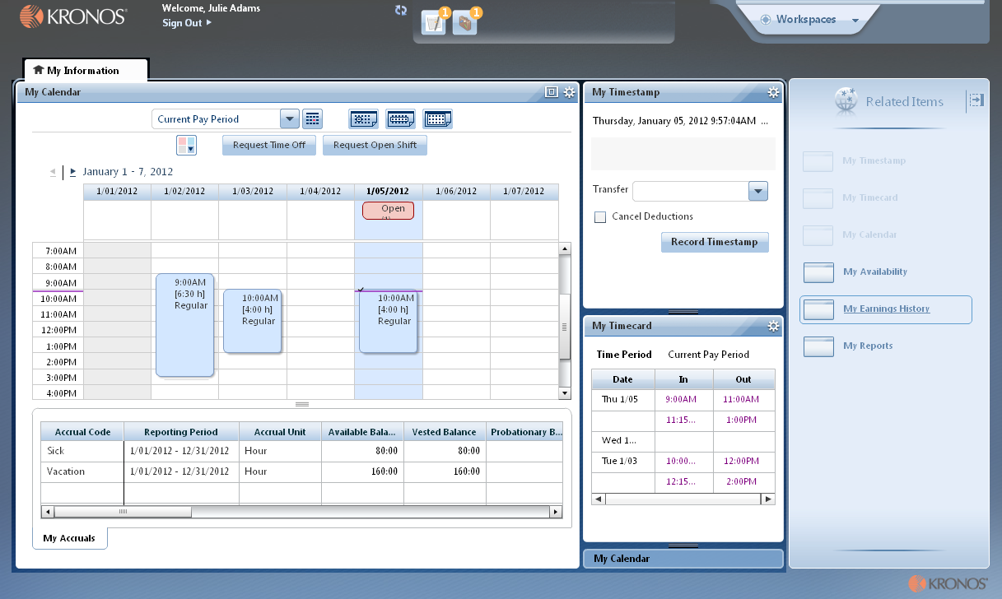
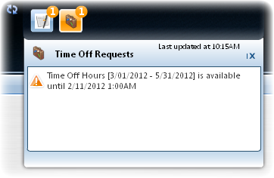
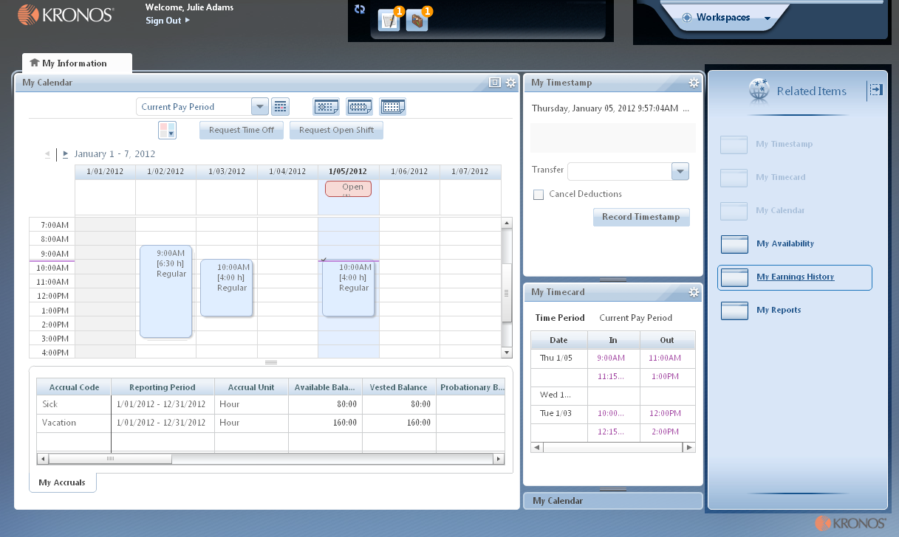
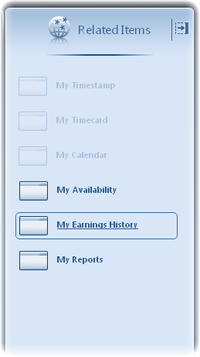
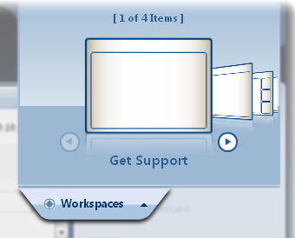
Employee Navigator Job Aid
Opening Widgets and Workspaces
Refresh Click the Refresh icon to get immediate updates to your Alerts.
Alert Icons Each type of alert has its own icon. A number in the icon’s corner indicates that there are items you should review. (The significance of the number itself depends on the specific alert.) Click an icon to view details.
Alert Details Click an item in the details of an alert to open the relevant widget. You can then take whatever actions are needed in the open widget.
Alerts
Carousel
Primary
Widget
Secondary
Widgets
Closing the Related Items Pane Click the right arrow to close the Related Items pane. When closed, click the left arrow to open it.
Related
Items
Active Widgets Widgets already in an open workspace appear grayed out in widget list.
Activating a Widget There are two ways to activate a widget in the Related Items pane. To add it to the current workspace, drag it out of the pane and release it over a widget in the workspace. To work with the widget in a separate workspace, click the widget while it is still in the pane. To close that workspace later, hover over its tab and click the Close (X) button.
Additional Workspaces Click an item in the carousel to open an additional workspace. To close that workspace later, hover over its tab and click the Close (X) button.
Related
Item
Cycling the Carousel If there is more than one workspace in the carousel, use the arrows to cycle through the additional workspaces.
Closing the Carousel Click the Workspaces tab to close the carousel.

Slide 4
Best Practices

