Slide 1
Welcome
Mario Torres
Investment Advisor Representative
Voya Financial Advisors
9400 Holly Ave NE, Bldg. 4,
Albuquerque, NM 87122
505-350-5421 Cell
Mario.Torres@voyafa.com
Securities and investment advisory services offered through Voya Financial Advisors, Inc., (member SIPC)
This seminar has been funded in whole/in part by University of New Mexico
Notes:
Use this slide as a template if you are an Investment Adviser Representative.
Prior to submitting to Advertising Review, add your name, title (optional), DBA (optional) and contact information.
If you do not have a DBA name, remove the DBA disclosure.
Keep the Guest Speaker line and disclosure line “as is” in case you decide to have a guest speaker at an upcoming seminar.
Keep the sponsor fund disclosure in case you may request sponsor funds at an upcoming seminar.
Submit this cover slide template along with a completed submittal Form to your OSJ to forward to Advertising Review at adreview@voya.com for review and approval as a cover slide template. Each time you host a seminar, you will need to update this cover slide with actual guest speaker information and/or sponsor fund information as appropriate.
If your event will not include a guest speaker, delete the guest speaker information and non-affiliation lines.
If your event will not be funded by an outside sponsor, delete: This seminar has been funded [in whole/in part] by (insert vendor name).

Slide 2
Close The Gaps In Your Financial Plan
Your Financial Journey
Mario Torres
Investment Advisor Representative

Slide 3
Close The Gaps In Your Financial Plan
Financial House
What’s Important to you
The Big Picture
It All Adds Up
Tax Planning
Estate Planning
Filling In the Gaps
Managing Financial Risks
Notes:
There are many reasons to have a bank account and for people raised in the U.S. it is rare for someone not to have one. You could possibly make money on your deposits. Savings account deposits up to specified amount are insured by the Federal Deposit Insurance Corporation (FDIC). With today’s technology you also have easy access to your account information.

Slide 4
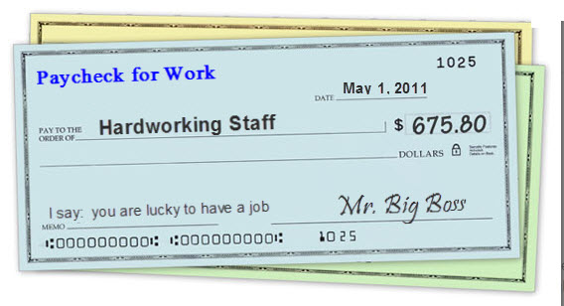
Close The Gaps In Your Financial Plan
Risk Management
Protect Your Current Health
Protect Your Loved Ones
Protect Your Income
Protect Your Future Health
Notes:
There are many reasons to have a bank account and for people raised in the U.S. it is rare for someone not to have one. You could possibly make money on your deposits. Savings account deposits up to specified amount are insured by the Federal Deposit Insurance Corporation (FDIC). With today’s technology you also have easy access to your account information.

Slide 5
Protect Your Current Health
UNM offers medical coverage options through three Third Party Administrators (TPAs).

Slide 6
Know Your Plans
Co-pays
Deductibles
Co-insurance %
Out of pocket maximums
Notes:
Many banks offer interest, making you money vs. not if you keep it in cash.
Check or debit cards offer convenience paying for goods and services.
Today’s technology offers the ability to monitor and track your purchases.
Building relationships at you local bank branch can make any loan application or banking services a more pleasant experience.
In today’s world carrying large sums of cash in your wallet or purse could bring unwanted attention to you. Keeping your money in a checking or savings account offers convenience and security.

Slide 7
Protect Your Loved Ones
What if something happens?
Who is dependent on you?
Income
Final expenses
Future Costs
Pay of debt
College education
Legacy

Slide 8
How Much Do I Need
http://www.legacyfg.net/learning_center/calculators/life_insurance
Current Salary - $50,000
How many years to provide 1-5?
Current debt
Mortgage - $200,000
Credit cards - $5,000
Car Loan - $15,000
College Education - $10,000 x 4 years
Legacy $50,000
Life insurance need is $410,000
Notes:
Many banks offer interest, making you money vs. not if you keep it in cash.
Check or debit cards offer convenience paying for goods and services.
Today’s technology offers the ability to monitor and track your purchases.
Building relationships at you local bank branch can make any loan application or banking services a more pleasant experience.
In today’s world carrying large sums of cash in your wallet or purse could bring unwanted attention to you. Keeping your money in a checking or savings account offers convenience and security.

Slide 9
Types of Life Insurance
Term
Group term – Through UNM
Individual term
5, 10, 20, or 30 year
Permanent
Whole life
Universal Life
Variable Universal Life
Notes:
Many banks offer interest, making you money vs. not if you keep it in cash.
Check or debit cards offer convenience paying for goods and services.
Today’s technology offers the ability to monitor and track your purchases.
Building relationships at you local bank branch can make any loan application or banking services a more pleasant experience.
In today’s world carrying large sums of cash in your wallet or purse could bring unwanted attention to you. Keeping your money in a checking or savings account offers convenience and security.

Slide 10
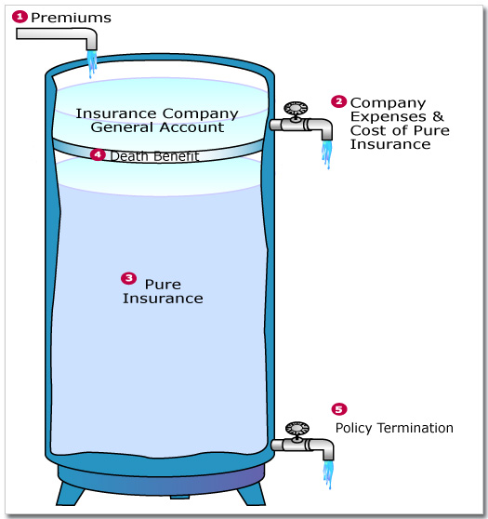
Term Life Insurance
Group term - https://hr.unm.edu/benefits/life-insurance
May purchase up to 3 times salary
Terminates upon separation from employment
Individual term
5, 10, 20, or 30 year
Terminates upon end of term
Coverage when need greatest
Notes:
Many banks offer interest, making you money vs. not if you keep it in cash.
Check or debit cards offer convenience paying for goods and services.
Today’s technology offers the ability to monitor and track your purchases.
Building relationships at you local bank branch can make any loan application or banking services a more pleasant experience.
In today’s world carrying large sums of cash in your wallet or purse could bring unwanted attention to you. Keeping your money in a checking or savings account offers convenience and security.

Slide 11
Permanent Insurance
Rent vs Own
Ability to lock in rates
Future health concerns not an issue
Builds Cash Value
Pension Maximization
ERB retirement
Pass pension on to heirs
Wealth Transfer
Notes:
Many banks offer interest, making you money vs. not if you keep it in cash.
Check or debit cards offer convenience paying for goods and services.
Today’s technology offers the ability to monitor and track your purchases.
Building relationships at you local bank branch can make any loan application or banking services a more pleasant experience.
In today’s world carrying large sums of cash in your wallet or purse could bring unwanted attention to you. Keeping your money in a checking or savings account offers convenience and security.

Slide 12
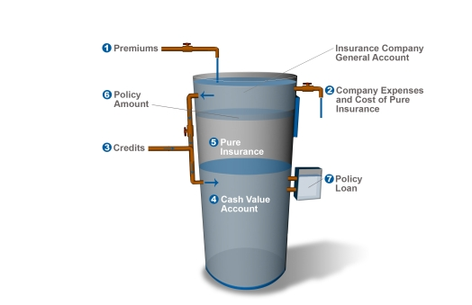
Whole Life Insurance
Pay premiums for life.
Builds Cash Value
Notes:
Many banks offer interest, making you money vs. not if you keep it in cash.
Check or debit cards offer convenience paying for goods and services.
Today’s technology offers the ability to monitor and track your purchases.
Building relationships at you local bank branch can make any loan application or banking services a more pleasant experience.
In today’s world carrying large sums of cash in your wallet or purse could bring unwanted attention to you. Keeping your money in a checking or savings account offers convenience and security.

Slide 13
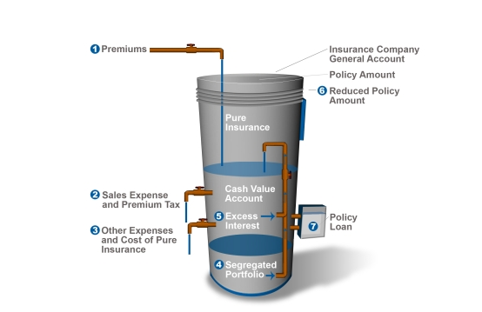
Universal Life Insurance
Pay premiums for life.
Flexible premium
May guarantee death benefit for specific time frame
Notes:
Many banks offer interest, making you money vs. not if you keep it in cash.
Check or debit cards offer convenience paying for goods and services.
Today’s technology offers the ability to monitor and track your purchases.
Building relationships at you local bank branch can make any loan application or banking services a more pleasant experience.
In today’s world carrying large sums of cash in your wallet or purse could bring unwanted attention to you. Keeping your money in a checking or savings account offers convenience and security.

Slide 14
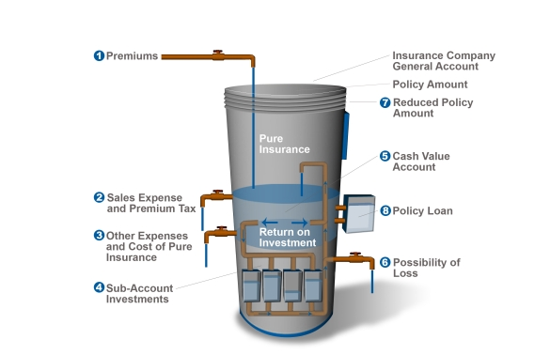
Variable Universal Life Insurance
Ties Into The Stock Market.
Death benefit may increase or decrease
No guarantee
Notes:
Many banks offer interest, making you money vs. not if you keep it in cash.
Check or debit cards offer convenience paying for goods and services.
Today’s technology offers the ability to monitor and track your purchases.
Building relationships at you local bank branch can make any loan application or banking services a more pleasant experience.
In today’s world carrying large sums of cash in your wallet or purse could bring unwanted attention to you. Keeping your money in a checking or savings account offers convenience and security.

Slide 15
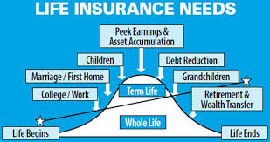
Planning Considerations
Combination Plan
Term insurance to cover when needs are greatest
Permanent to cover final expenses
Notes:
Many banks offer interest, making you money vs. not if you keep it in cash.
Check or debit cards offer convenience paying for goods and services.
Today’s technology offers the ability to monitor and track your purchases.
Building relationships at you local bank branch can make any loan application or banking services a more pleasant experience.
In today’s world carrying large sums of cash in your wallet or purse could bring unwanted attention to you. Keeping your money in a checking or savings account offers convenience and security.

Slide 16
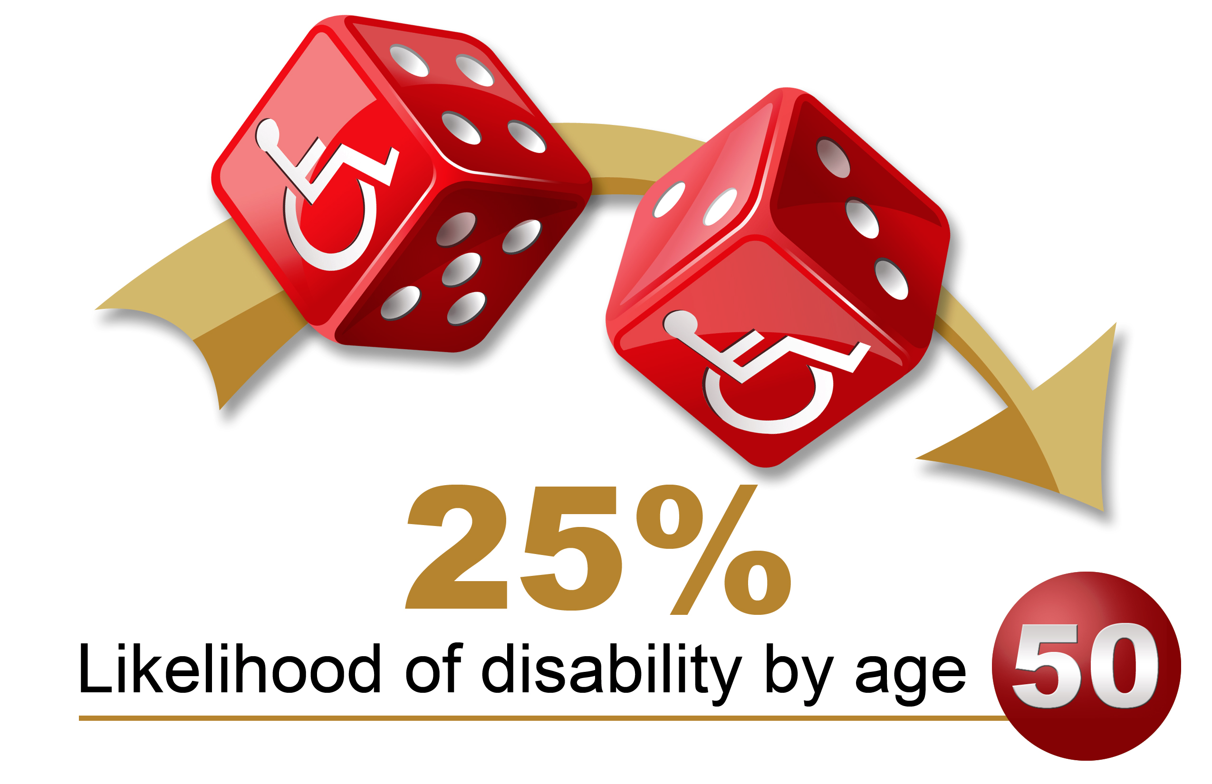
Protect Your Income
What happens if you couldn’t work?
Illness
Accident
Who provides for family?
What is your chance of becoming disabled?
20 year old worker 30% B-4 Retirement – SSA
Notes:
Many banks offer interest, making you money vs. not if you keep it in cash.
Check or debit cards offer convenience paying for goods and services.
Today’s technology offers the ability to monitor and track your purchases.
Building relationships at you local bank branch can make any loan application or banking services a more pleasant experience.
In today’s world carrying large sums of cash in your wallet or purse could bring unwanted attention to you. Keeping your money in a checking or savings account offers convenience and security.

Slide 17
Protect Your Income
Any disease or injury that is severe enough can cause disability. Must be medically certifiable, expected to last for a certain period of time, and impair your ability to do your own job, any other job, or both.
Notes:
We will now discuss how credit affects purchases you make.

Slide 18
Protect Your Income
Government Protection?
Workers Compensation – Only if work related
Social Security
6 month waiting period
May cover only a portion of need
ERB Pension
10+ Years of Service
Must be totally disabled and cannot work
Notes:
Many banks offer interest, making you money vs. not if you keep it in cash.
Check or debit cards offer convenience paying for goods and services.
Today’s technology offers the ability to monitor and track your purchases.
Building relationships at you local bank branch can make any loan application or banking services a more pleasant experience.
In today’s world carrying large sums of cash in your wallet or purse could bring unwanted attention to you. Keeping your money in a checking or savings account offers convenience and security.

Slide 19
Protect Your Income
How it works
Choose elimination period
Choose $ amount
Choose benefit period
Types of Disability Insurance
Short-term
Long-term
Group disability plans
Private plans
Notes:
We will now discuss how credit affects purchases you make.

Slide 20
Protect Your Income
UNM short-term disability
30 day elimination
60% of income
6 month benefit period
UNM long-term disability
6 month elimination period
60% of income benefit
UNM Plans end with employment
Notes:
We will now discuss how credit affects purchases you make.

Slide 21
Protect Your Income
Private plans
You pay the premiums
Flexible options – Plan design
Control of the plan
Portable
Notes:
We will now discuss how credit affects purchases you make.

Slide 22
Protect Your Future Health
Long-Term Care
Unable to perform activities of daily living (ADLs) - eating, bathing, dressing, continence, toileting (moving on and off the toilet), and transferring (moving in and out of bed).
Your doctor has ordered specific care.
Your care is medically necessary.
Your mental or cognitive function is impaired.
You've had a prior hospitalization of at least three days (this is rare with newer policies).
Notes:
We will now discuss how credit affects purchases you make.

Slide 23
Protect Your Future Health
Notes:
We will now discuss how credit affects purchases you make.

Slide 24
Protect Your Future Health
Long-term Care
The odds of needing long-term care are high:
Approximately 70% of people will need long-term care at some point during their lifetimes after reaching age 65*
Approximately 8% of people between ages 40 and 50 will have a disability that may require long-term care services*
Notes:
We will now discuss how credit affects purchases you make.

Slide 25
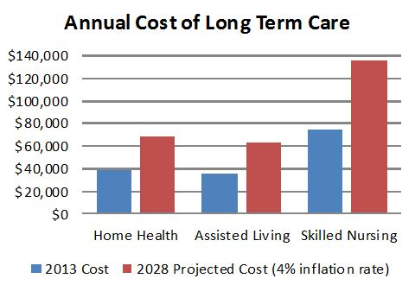
Protect Your Future Health
The cost of long-term care can be expensive*:
$6,235 per month, or $74,820 per year for a semi-private room in a nursing home
$6,965 per month, or $83,580 per year for a private room in a nursing home
$3,293 per month for a one-bedroom unit in an assisted living facility
$21 per hour for a home health aide
*U.S. Department of Health and Human Services,
December 1, 2015
Notes:
We will now discuss how credit affects purchases you make.

Slide 26
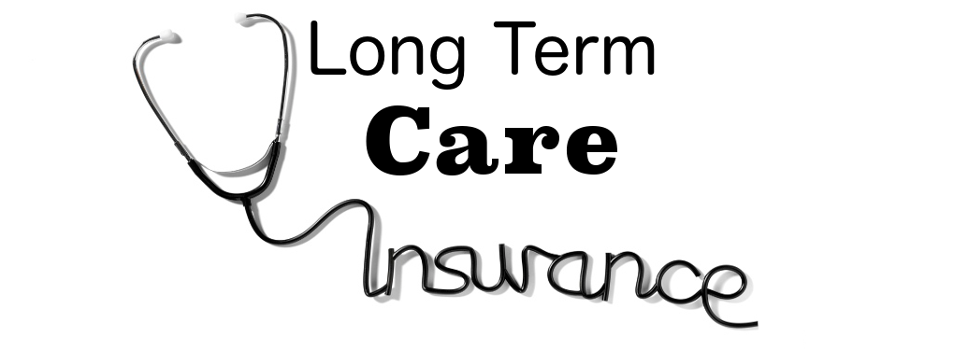
Protect Your Future Health
How do I pay for long-term care?
Notes:
We will now discuss how credit affects purchases you make.

Slide 27
Protect Your Future Health
Medicare does not pay the largest part of long-term care services or personal care—such as help with bathing, or for supervision often called custodial care.
Medicare will help pay for a short stay in a skilled nursing facility, for hospice care, or for home health care if you meet the following conditions:
You have had a recent prior hospital stay of at least three days
You are admitted to a Medicare-certified nursing facility within 30 days of your prior hospital stay
You need skilled care, such as skilled nursing services, physical therapy, or other types of therapy
Medicare will pay for some of your costs for up to 100 days.
For the first 20 days, Medicare pays 100 percent of your costs.
For days 21 through 100, you pay your own expenses up to $140.00 per day (as of 2013), and Medicare pays any balance.
You pay 100 percent of costs for each day you stay in a skilled nursing facility after day 100.
http://longtermcare.gov/medicare-medicaid-more/medicare/
Notes:
We will now discuss how credit affects purchases you make.

Slide 28
Protect Your Future Health
Medicaid covers nursing home services for all eligible people age 21 and older.
Must meet income eligibility requirements
Medicaid also covers home and community-based services for people who would need to be in a nursing home if they did not receive the home care services.
In most states, Medicaid will also cover services that will help you remain in your home, such as
personal care services, case management, and help with laundry and cleaning. Medicaid will not pay for your rent, mortgage, utilities, or food.
It is important to understand that Medicaid proprams and eligibility for services vary from state to state.
Notes:
We will now discuss how credit affects purchases you make.

Slide 29
Protect Your Future Health
Things to consider
Benefit amount: What is the maximum your policy will pay for your care each day, generally ranges from $50 to $350 or more.
Benefit period: The length of time your policy will pay benefits (e.g., 2 years, 4 years, lifetime).
Elimination period: The number of days you must pay for your own care before the policy begins paying benefits (e.g., 20 days, 90 days).
Types of facilities included: Many policies cover care in a variety of settings including your own home, assisted living facilities, adult day care centers, and nursing homes.
Inflation protection: With inflation protection, your benefit will increase by a certain percentage each year. It's an optional feature available at additional cost, but having it will enable your coverage to keep pace with rising prices.
Notes:
We will now discuss how credit affects purchases you make.

Slide 30
Protect Your Future Health
Your current age: | 55
Age you begin to use long-term-care services: | 80
Assumed inflation rate for long-term-care services: | 5%
The current daily cost of a nursing/long-term care facility: | $230
Based on your answers, the average daily cost when care is needed: | $779
Monthly, this works out to: | $23,690
Total estimated cost if you need one year of long-term care: | $284,284
Total estimated cost if you need three years of long-term care: | $896,207
Total estimated cost if you need five years of long-term care: | $1,570,851
Total estimated cost if you need 10 years of long-term care: | $3,575,700
Notes:
We will now discuss how credit affects purchases you make.

Slide 31
Protect Your Future Health
Long-term care through UNM
https://hr.unm.edu/benefits/long-term-care
Up to $4,000 maximum monthly benefit
Benefit period 3 year or 6 year
4 plan options
Plan 1 no inflation
Plan 2 total home care
Plan 3 inflation – simple int. 5%
Plan 4 inflation & total home care
Elimination period – 90 days
Plan is portable
Notes:
We will now discuss how credit affects purchases you make.

Slide 32
Protect Your Future Health
Private Long-term Care Insurance
Flexibility on plan design
Elimination Period
Benefit period
Benefit amount
Home Health Care
Smaller premium increases
Risk of employer change
Close the gap on employer Insurance
Notes:
We will now discuss how credit affects purchases you make.

Slide 33
Protect Your Future Health
Links
www.legacyfg.net
www.360financialliteracy.org
www.voya.com
Notes:
We will now discuss how credit affects purchases you make.

Slide 34
Be Informed
Living in the United States offers us many opportunities that do not exist to all, in other countries. It also has its own unique risks.
Please educate yourself on these risks so you and your family have the tools to help you preserve what you’ve worked so hard to build.
Notes:
Read slide.

Slide 35
Questions?
Contact Mario Torres
505-350-5421
Mario.Torres@voyafa.com
www.legacyfg.net

